Slide 1

CSS Advanced
Course Overview
SoftUni Team
Technical Trainers
Software University
http://softuni.bg

Slide 2
Table of Content
Introduction
Training and Team
Course Objectives
Course Organization

Slide 3
Have a Question?
sli.do
#front-end

Slide 4












SoftUni Diamond Partners

Slide 5
SoftUni Diamond Partners

Slide 6
CSS Advanced
Course Objectives & Program

Slide 7

CSS Advanced – Course Topics
Course Topics
File Organisation, Version Control
CSS Variables
3. CSS Transitions and Animations
4. CSS Grid
5. SASS

Slide 8
CSS Advanced – Course Topics
6. Project Consultation
7. Exam

Slide 9

Trainers and Team

Slide 10
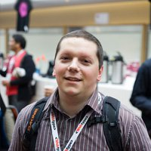
Konstantin Dankov
Senior UX/UI Engineer in DevriX
17 years experience with HTML and CSS
Started working as a Front-End developer
when he is 18 years old – at that time Firefox
did not exist and Internet Explorer 6 was a
modern browser

Slide 11
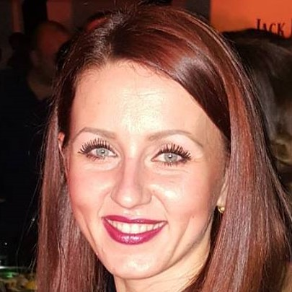
Maya Boyadzhieva
Junior Front-End Developer in DevriX
Experience in JS, HTML5, CSS3, C#

Slide 12

Course Objectives
Course Details and Schedule

Slide 13

Training Duration
Lessons: ~32 hours (onsite + videos)
Practical exercises (in class): ~8 hours
Defense date: 11 August 2019
Retake defense date: 15 August 2019
Project Defense: 15 minutes

Slide 14
Exam
Project Defense
Requirements for Project Assignment:
Project Defense: 15 minutes
You can defense your project in SoftUni or online via Skype
Examples
https://softuni.bg/trainings/2427/css-advanced-july-2019#lesson-12418
https://donchomitev.github.io/CoffeeShop/
https://ddanailova.github.io/baby-album/

Slide 15

Course Organization
Resources

Slide 16

Evaluation Criteria
Mandatory
Final exam – 95%
Exercises & homework – 5%
Bonuses
Presence in class – 5% bonus (onsite students only)

Slide 17

Homework Assignments
Each lesson is followed by a few exercises
Homework assignments are due in 7 days after each lesson
Submission through the course page

Slide 18
Learn to Search in Internet & Find Solutions
The course assignments require to search in Internet
This is an important part of the learning process
Some exercises intentionally have no hints
Learn to find solutions!
Software development includes everyday searching and learning
No excuses, just learn to study!
Developers learn new technologies, tools, languages every day!

Slide 19
Website, Forum and FB Group
Official website:
Official discussion forum:
Official Facebook group:
https://softuni.bg/trainings/2427/css-advanced-july-2019
https://softuni.bg/forum/categories/68/web-basics
https://www.facebook.com/groups/FrontEndMay2019/

Slide 20
Code Editors
You may try many HTML authoring tools
Recommended:
Visual Studio Code
Other notable editors:
WebStorm
Sublime Text / Atom / Brackets

Slide 21
https://softuni.bg/trainings/2427/css-advanced-july-2019

Slide 22




Trainings @ Software University (SoftUni)
Software University – High-Quality Education and Employment Opportunities
softuni.bg
Software University Foundation
http://softuni.foundation/
Software University @ Facebook
facebook.com/SoftwareUniversity
Software University Forums
forum.softuni.bg

Slide 23

License
This course (slides, examples, demos, videos, homework, etc.) is licensed under the "Creative Commons Attribution-NonCommercial-ShareAlike 4.0 International" license

